Slide 1
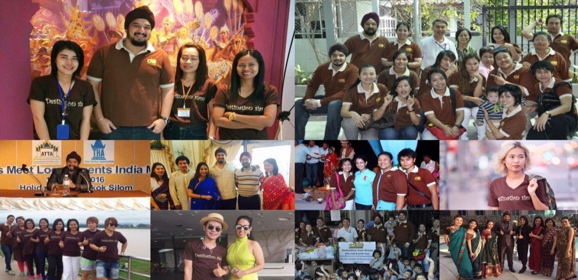
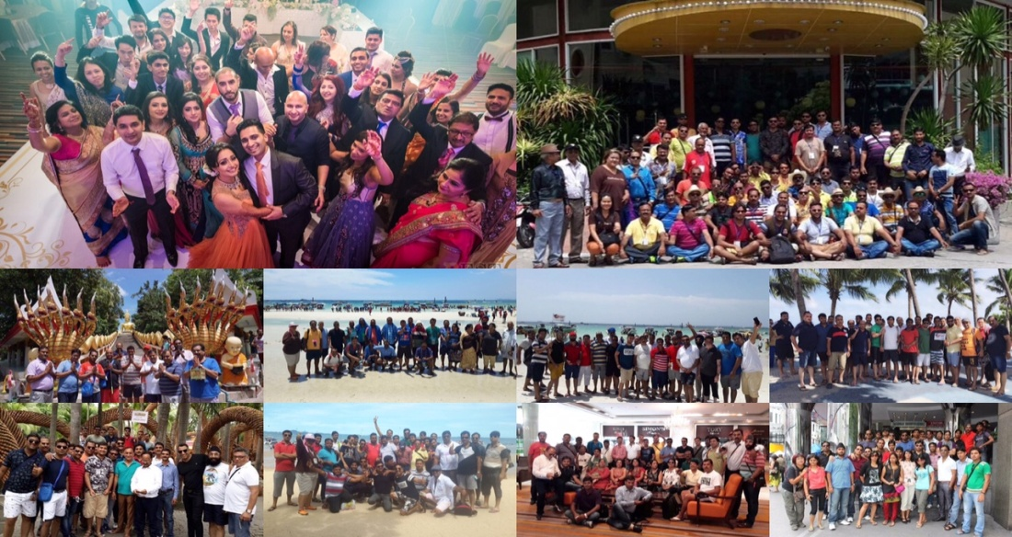
Destination Siam Group (DSG)
About DSG
13 years in the Business (Inbound market)
Expertise In South Asia and Middle East Market
Top List Destination Management Company in Thailand for Indian Market
Group Operated by well trained Staff
Well Known for High quality of service at all times
Recent MICE by DSG
AUGUST 2016
Bajaj Alliance (Pan India) : 950 pax
Wedding Group (Mumbai) : 400 pax
Classic Parivar Group (Mumbai) : 150 Pax
JULY 2016
IPPF Group (Worldwide) : 85 pax
Kamdhenu Steel Group (Pan India): 200 pax
P&G Group (Pan India) : 150 pax
www.destinationsiam.com
For Mice/Tour: Destinationsiamgroup For Wedding: DestinationWeddingsThailand

